Slide 1
Answering Big Questions with Small Data
Olya Flores
ML R&D Lead
Leidos Cyber

Slide 2
Big Data is Great.

Slide 4
Big Data
Small Data
Hundreds of terabytes! Petabytes!
Non-relational, unstructured
High-rate streaming
Smaller in size
Imbalanced: lots of data from one class, little from another class
Not labeled, or lacking truth data
Updated in batch mode (hourly… weekly…. Every solstice…)
Stored in fragments, controlled by fiefdoms
Prevalent in fields that have been around for a bit

Slide 5
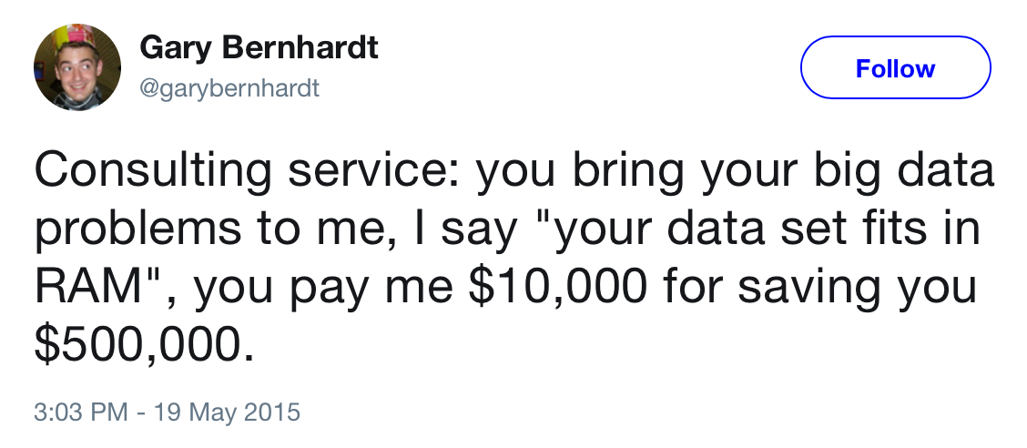
Many organizations have data that’s
Heavily normalized
Fragmented & disjointed
Imbalanced
Free of context
Small in volume
Not labeled

Slide 6
Learning with Small Data
Risk of overfitting
Low Accuracy
Lots of SME time

Slide 7
Caution!
This presentation itself is an example of learning from small datasets
The topic is complex, and our discussion very short
This should only be your starting point
Each approach must be used correctly
Review papers before proceeding
Do your math

Slide 8
Types of Learning
Supervised
Unsupervised
Truth data
Lots of data to play with
Lots of time to train

Slide 9
Simplify!

Slide 10
Feature Engineering
Before Deep Learning, feature engineering was where we spent most of our time; it is expensive and slow, especially when esoteric domain expertise is needed
When using small data to learn, Feature Selection becomes even more critical
For small datasets:
Use implicit Feature Selection for non-zero parameters
Feature Regularization
Feature Sampling/Importance Sampling
Do not decouple feature selection from model selection!

Slide 11
Balance and Augment
Over and under-sampling
Used to balance the data classes. It seems so simple, but affects so much!
Oversampling will make it look like data has less variance (undersampling the majority class instead seems to work better)
Generative Models
Take the predictions with highest certainty that your model produces
Introduce those predictions back into the training set

Slide 12
Adaptive Sampling
Actually designed to help reduce training times on very large data sets
Instead of starting out with a very large dataset, instead start with a subset, and dynamically increase your sample size to adapt to how well the classifier is performing
Eventually you will plateau - then, stop increasing the size (balance the complexity of the model with the classification accuracy you are looking to achieve)
Use learning on existing datasets to estimate necessary variation (complexity) and size to achieve reasonable results for your use case
Build large number of models with varying subsets of data for variable selection

Slide 13
Other things to try
(deep cuts)
Use intervals instead of points (change the range space for predictions)
Use bivariate models: reduce the problem
Choose better priors in Bayesian methods
Combine LDA and PLS for dimension reduction (or try PCA-LDA, especially if there’s correlation)
SparseLab: or sparse systems, try combining linear approaches to select signal from noise even when you have many more dimensions than observations

Slide 14
Domain SME will save you
Evaluate Data Quality
Is data relevant?
Make sure sample is representative
Future out the right features
Label more data

Slide 15
Get yourself a domain SME

Slide 16
Beware of your Domain SME!
Data?
Data Cleaning
Feature Engineering
Class Balancing
……
Or rules, implicitly expressed as data?
Small subset of complex data
Make your assumptions explicit:
consider building a rule-based system instead.

Slide 17
Help The Learner

Slide 18
Boosted Decision Trees
Getting weak learners to grasp the concept as a team!

Slide 19
Boosted Decision Trees
A series of weak learners, where each is building on the hypothesis achieved by the prior learner
Define:
A loss function to optimize
An initial weak learner that will make our predictions
An additive model, which will add more learners to minimize our loss function
Improvements:
Tree Constraints
Shrinkage
Random Sampling
Penalized Learning….

Slide 20
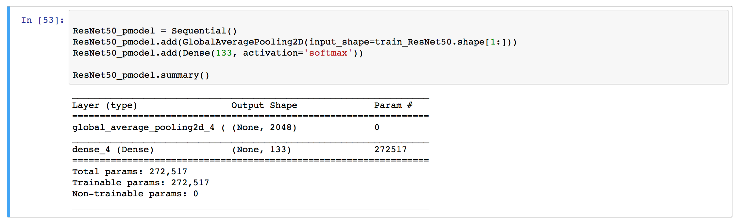
Transfer Learning
Take a learner who is already very capable, and can solve a problem similar to ours very, very well
Train this learner just a little bit more on the small amount of data we have

Slide 21
Dog breed classification
A dataset of 8k classified dog breed images
131 breeds (categories)
A random guess has accuracy < 1%
A CNN trained from scratch:
Not the same breed. Very different.
Accuracy:
5 epochs just to get to above random chance (>1%)
20 epochs is nothing to write home about either (< 10%)

Slide 22
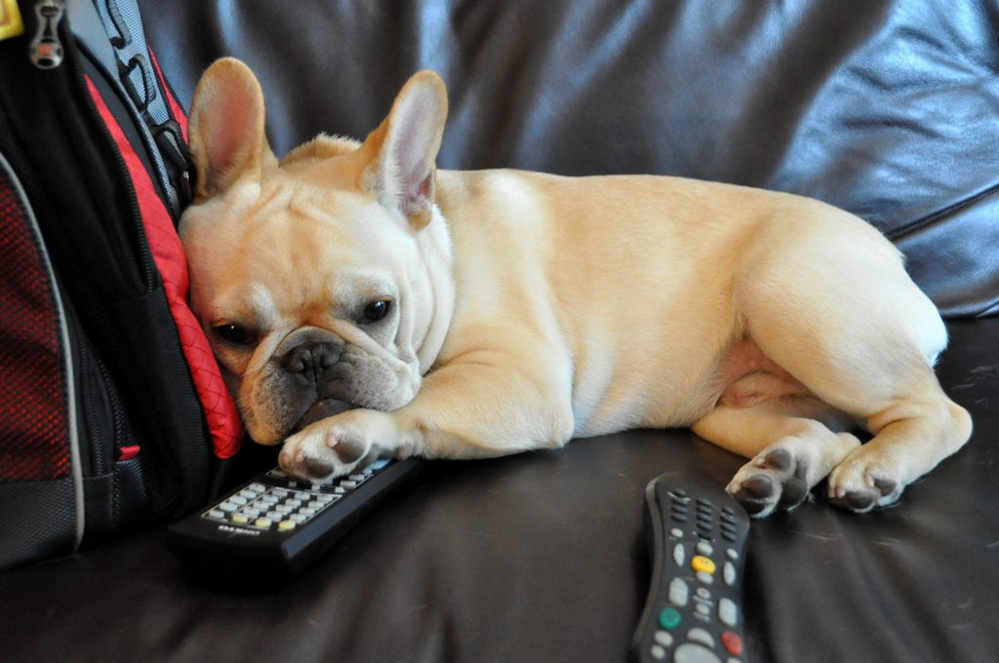
Use Transfer Learning to classify dog breeds
Model: ResNet50
Images in ImageNet: >14 million, 1 mil in train set
A dataset of 8k classified dog breed images
131 breeds (categories)
20 epochs
A random guess has accuracy < 1%
The person in the image is reminiscent of a English_cocker_spaniel
Accuracy: 80.1435!
The dog in the image looks like a French_bulldog

Slide 23
Why does it work?

Slide 24
Types of Learning
Supervised
Semi-Supervised!
Unsupervised

Slide 25
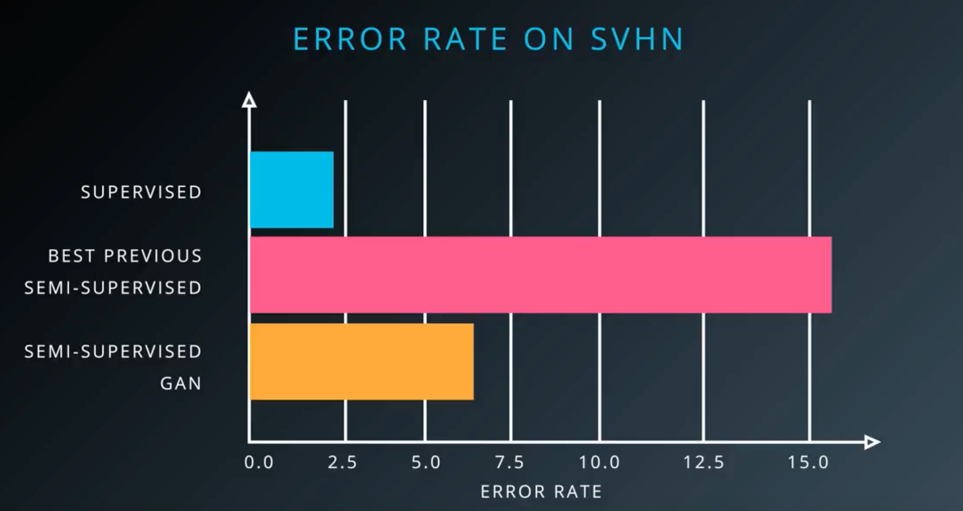
Semi-Supervised Generative Adversarial Networks (GANs)
Train on:
Labeled real data
Unlabeled real data
Fake, generated data

Slide 26
Data Programming
Get users to provide heuristics (labeling functions) instead of labeling specific data points. They are usually high precision and low coverage: regexps for text, etc.
Feed the system both these heuristics and the unlabeled data
These heuristics are going to be noisy (lots will have false negatives and false positives)
The system will evaluate heuristics and give each one a label of how well it did
Instead of one ground truth label, each data point will now have multiple probabilistic fuzzy weak labels
This allows for generalization!
snorkel.stanford.edu

Slide 27
General Rules
Crowdsourcing
A group of weak learners > one strong one
Fuzzy is better than precise
Transfer Learning works great! Boosted trees are not bad either!
Use heuristics instead of labels for truth data

Slide 28
Focus on the Future
Build in labeling during data creation: help future learners!
Consider changing what you collect and store
If possible, join in data sharing efforts - and data anonimization research!
Use more than one SME
Use heuristics instead of labels
If you are actually learning rules, make that explicit

Slide 29
Dig in
Feature Engineering
Feature Normalization
Implicit Feature Selection
Feature Sampling
Importance Sampling
Class Balancing
Oversampling and undersampling
Adaptive Sampling
Model selection in sparse data sets (more dimensions than observations)
SparseLab Boosted Decision Trees
Transfer Learning
An easily digestible overview of transfer learning
Sample image classification transfer learning notebook (also has bottleneck features for each network type below)
Applications in Keras: VGG-19, ResNet50, Inception, Xception
Semi-supervised Learning
Semisupervised GANs
Semi-Supervised Learning Method Survey
Data Programming: read and listen
Snorkel
Comparative Studies
Comparative study of classifiers
Comparative study of classifiers on small data sets
lambdakrolik/small-dataset-learn
lambdakrolik/TL-dog-project

Slide 30
Thank you!

Slide 31
Image Credits
Slide 1: https://warfortalent.files.wordpress.com/2011/04/elephant.jpg
Slide 3:
http://www.njwight.com/wp-content/uploads/2016/03/elephant_Ear_njwight.jpg
http://www.stevebloom.com/images/b/003831-SB1.jpg
http://l7.alamy.com/zooms/3c38630ed0e24bb088179a47988d5ca4/a-close-up-of-an-elephant-trunk-taken-at-knysna-elephant-park-south-cntgb0.jpg
http://l450v.alamy.com/450v/htxpaf/african-elephant-tail-close-up-htxpaf.jpg
Steve Bloom: http://www.bonuel.ca/blog/wp-content/uploads/2010/02/Steve-Bloom.jpg
Elephant skull: https://ih0.redbubble.net/image.121892482.8084/flat,800x800,075,f.u2.jpg
Kids on Playground: http://www.tcsatl.org/wp-content/uploads/2015/09/DSC02020.jpg
Teacher and students: http://4.bp.blogspot.com/-yQzNm6vvHM8/UMQZMJ5qrAI/AAAAAAAADrA/tYPVcUNtLVc/s1600/norman-rockwell-happy-birthday-miss-jones-march-17-1956.jpg
Lecture hall: http://destinationfemme.com/wp-content/uploads/2014/10/lecture-feature.jpg
Dumbo: https://vignette.wikia.nocookie.net/disney/images/7/76/Dumbo-HQ.JPG/revision/latest?cb=20091210033559
Transfer learning step by step: https://cdn-images-1.medium.com/max/1600/0*jQ0pyjQn1yzZSARN.png
GAN: https://ieeenitk.org/blog/assets/img/GAN/GAN.png

